Slide 1
Software Evolution
Open Source
An overview of software evolution and maintenance in open source projects

Slide 2
What is Open Source?
Open source describes a broad general type of software license that makes source code available to the general public with relaxed or non-existent copyright restrictions.

Slide 3
What is Open Source?
So what does that mean?
“…software that is collectively developed by a community of technologists with an interest in a particular application or tool and then distributed at no cost to the broader community of individuals who can find a use for it…”
From open stacks to open source Joe Lucia, Villanova University, February 5, 2008 http://pln.palinet.org/wiki/index.php/From_open_stacks_to_open_source

Slide 4
What is Open Source? Really?
Free to use
Free to change
Free to distribute
An alternative to commercial software
More info at:
http://pln.palinet.org/wiki/index.php/Why_look_at_open_source_now%3F#What_is_meant_by_open_source

Slide 5
Open Source Alternatives to Microsoft Office
Open Office (Windows, Linux)
  http://www.openoffice.org/
Neo Office (Mac)
http://www.neooffice.org/

Slide 6
Open Source Technologies
Angular ( web development )
  https://angular.io
  https://github.com/angular
React ( web development )
https://reactjs.org
https://github.com/facebook/react/

Slide 7
Software evolution and maintenance in open source
How ( corrective – adaptive – perfective – preventive ) are done in open sources projects like angular or Linux ??

Slide 8
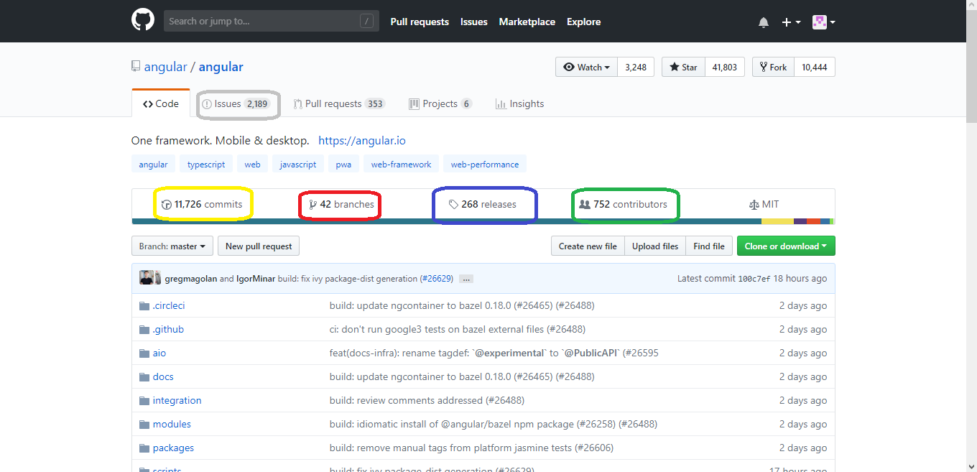
Community help ?

Slide 9
Community members can log
  Issues
  Proposed new features
  Non-functional problems
If the logged suggestions get validated to be as reported , they are planned in the next releases or as hot fixes.

Slide 10
Pull Requests ??
Since the name “open source” means you CAN contribute the project , you can actually solve the logged issue , or develop the new proposed feature !!!
Pull Requests are validated through “build agents” and “automated unit testing” that they INDEED solve the issue or don’t break any old features.

Slide 11
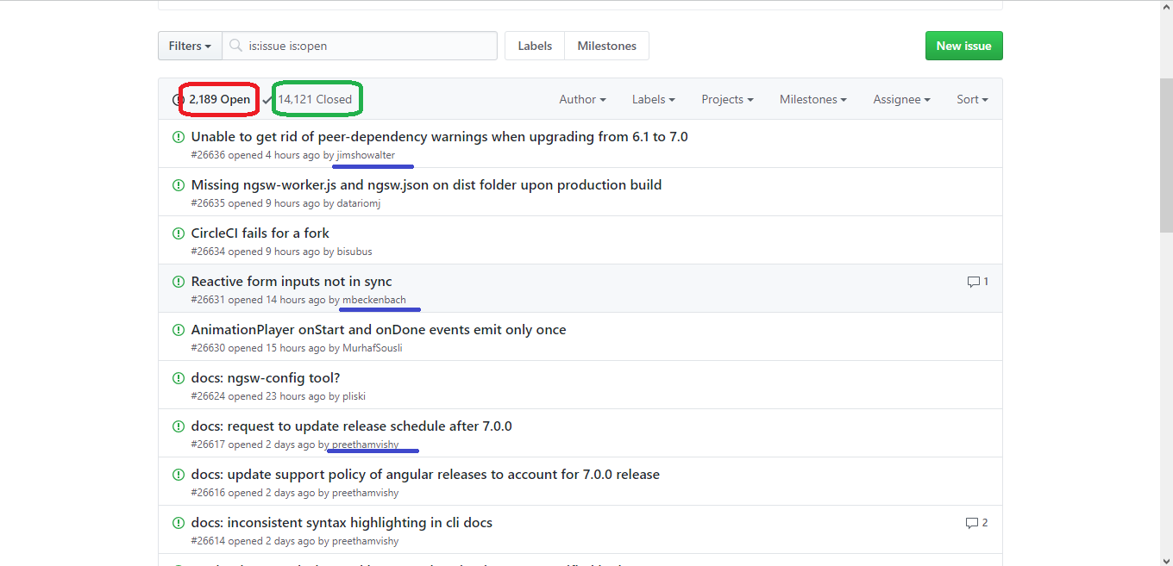
Issues Reporting

Slide 12
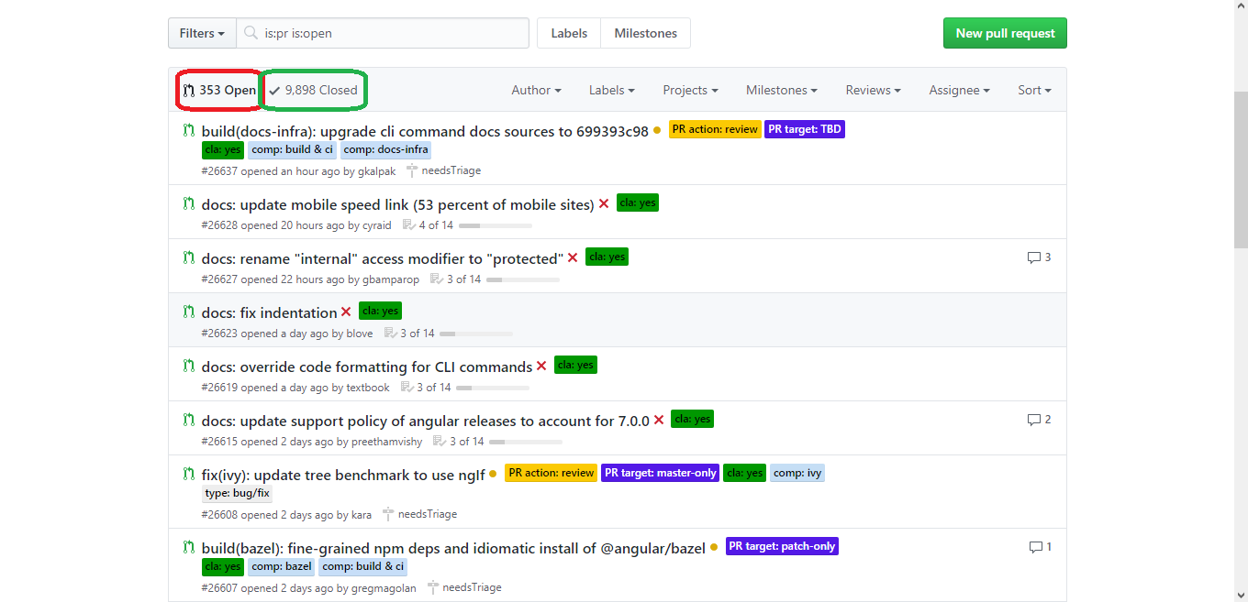
Pull Requests

Slide 13
Open source evolution
https://github.com/angular/angular/pulse
https://github.com/angular/angular/graphs/contributors
https://github.com/angular/angular/graphs/commit-activity

Slide 14
Questions

